Slide 1
Data and Model Monitoring
with function decorators in Python
Big Data LDN - 22/09/2021

Slide 2

Agenda
Part 2
5. Function decorators fundamentals
6. Building a monitoring decorator
7. Brining it all together
Part 1
What is Data and Model Monitoring?
Stages of the ML Pipeline
Data monitoring strategies
Model monitoring strategies
Repo: https://github.com/viktivan19/monitoring

Slide 3
What is Data and Model Monitoring?
And why should you care about it?
Data and model monitoring is one of the most crucial steps in building robust automated ML systems.
Things that can go wrong:
the data quality deteriorates
model performance deteriorates due to data shifts
Monitoring checks are parts of the ML pipeline that ensures that data corruption and performance deterioration is flagged on time.
Notes:
It’s one of the most crucial elements of a robust, fully automated ML system.
When you’re getting a machine learning model ready for production, ideally you don’t want to:
see your data quality deteriorate
or the model performance getting worse due to changing data.
But these things might happen due to reasons outside your control so the best way to prepare for it is to implement checks through the data and model pipeline that will tell you that something has changed and needs your attention.
Sometimes when your data changes, it will straight out break your pipeline at some point, for those edge cases you will want to detect the change and log it with useful information so you can get to fixing the issue as soon as possible.
However, sometimes the data shifts gradually so you don’t notice it until your model is producing results that are not meeting your requirements anymore.
Implementing data and model monitoring checks will help you catch issues as they arise and will enable you to fix them before they lead to material problems.
In doing so, you are making sure that your model is robust and it will keep running successfully in production without much human interaction.
You might ask, what happens if you don’t have the most crucial checks in place? Best case scenario your pipeline code will break at some point because some of the data ingested are corrupt. Worst case scenario the model runs successfully but produces incorrect/corrupt results which might have big negative impact for your stakeholders or clients.

Slide 4
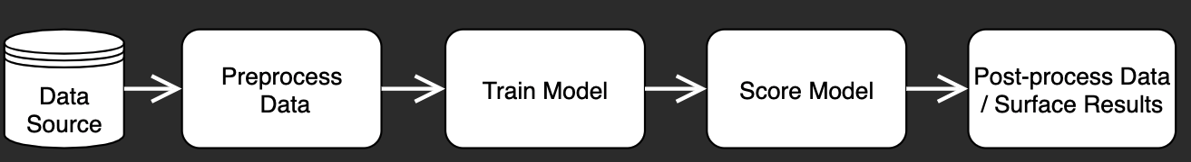
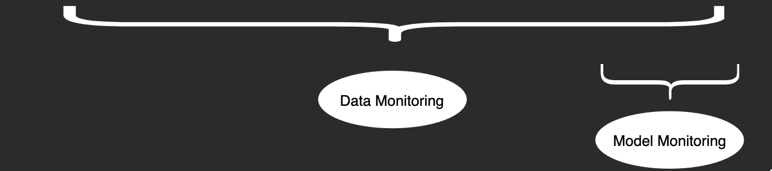
Stages of the ML Pipeline
Notes:
You could ask: at which part of the ML pipeline do we need to think about adding validation checks? Well, ideally you will have some checks at every stage of the process. Data monitoring should start from the point at which you ingest your data from the data source into the pipeline there should be checks on the raw data. Then as you are carrying out the preprocessing steps, you will want to make sure that the processes were able to produce the expected outcomes. Then, you can check the data right before it is fed into the model and also at the point when you are getting the predictions. Lastly, you might want to check if the predictions are within certain boundaries you would expect and the post-processed data has the right shape.
When it comes to model monitoring, you should implement the checks after you’ve produced the results.
Lastly, I won’t cover it in much detail but it can be super useful to think about global overarching monitoring checks that are tracking the operational side of the execution. e.g. how much of the resources on the cluster were consumed, memory usage, execution time, system downtime

Slide 5

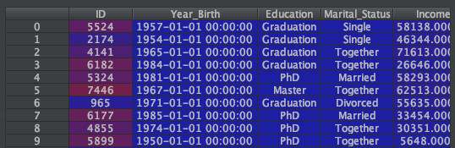
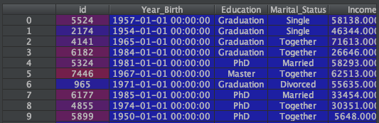

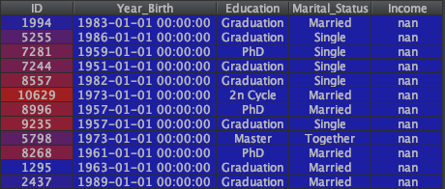
Data Monitoring
- Input -
Preprocessing checks:
Data ingestion checks - did the pipeline return all the data?
Data schema checks - are the data types and schema as expected?
Missing value checks - are there more missing values than expected?
Notes:
Now I will go into detail on what type of strategies there are. First I will talk about checks for the input, i.e. data monitoring and then I will cover the output checks, i.e. model monitoring.
First let’s look at some input checks that look for the existence of your data.
A trivial but frequent issue is when the model doesn’t receive data in the first place, or only fraction of the data that would be expected. E.g. Something to think about: when the data source is reliant on an upstream process and that process fails for some reason, are you going to be notified? If not, have checks in place that simply assess whether the pipeline returned all the data you were expecting.
Secondly, the schema of the source data might change for valid reasons but it can lead to issues later down the line. Things to check would be the columns, data types and data formats of the newly ingested data.
E.g. are all the column names as expected? even a small change can cause issues. or another example, if you’re working with dates, check that the format of the date time is as required.
Next, you might want to check if you received any missing values or if you know there will be some missing values, check that the proportion of missing values is not larger than acceptable.

Slide 6
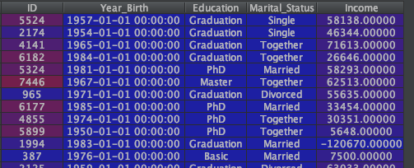

Data Monitoring
- Input -
Feature value checks:
are the values within the expected range?
standard deviation, quantiles, min-max ratio
categorical features: frequency of each category
Notes:
Now we’ll look at strategies to check the quality/consistency of your data.
Even if everything seems right with the data from a schema perspective, it doesn’t yet mean that the data is not corrupted. Feature value checks are important to flag changes in your data that would not break the model pipeline but it might corrupt the training and thus the results.
What if the features contain values that are incorrect/impossible? E.g. going back to the date time example, what if the “purchase date” in a transactions dataset is in the future? Or the transaction amount negative? Or the age of the customers above 200?
Secondly, if the data characteristics shift unexpectedly, it might mean that the model’s tuned parameters are not going to be applicable for the new dataset and you would need to tune it sooner than planned. Some checks that could be run are the mean, standard deviation, quantiles, min-max ratio.
Alternatively, you could implement some of the Nelson rules - these are checking values that are “out-of-control”. Eg. Nelson rule 1 checks if one point is more than 3 standard deviations from the mean. or nelson rule 2 checks if nine (or more) points in a row are on the same side of the mean - useful for time series validation.
lastly, if you’re working with categorical data, you can be checking the frequency of each category, e.g. did one category disappear in the new dataset?
We will see the implementation of some of these checks in a bit.

Slide 7
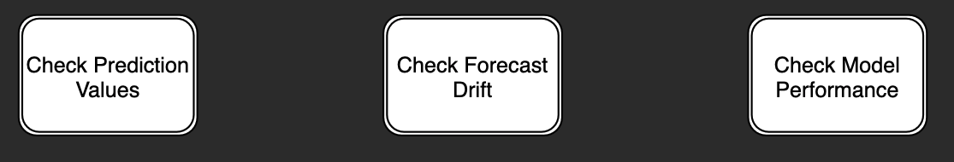
Model Monitoring
- Output -
Are the predictions within an expected range?
Are all the expected values present after post-processing?
For time series forecasts
Are the new forecasts very different from the previous forecasts?
On a recent dataset where the actuals are observed
E.g. RMSE, ROC, accuracy
Notes:
After the predictions are produced, you can implement a number of different types of model monitoring checks.
Similarily to the data quality checks discussed before, some checks can be carried out on the predictions from the model. E.g. are there any extreme predictions that you would like to be flagged? If there were any post processing steps carried out, then you can check if all the expected values are there.
If you have produced a forecast for which you haven’t observed the actuals yet, you can implement a model stability check that assessed how different the new forecast is from the forecast from previous runs and flag if there is a sudden significant change.
Lastly but perhaps most importantly, model monitoring checking performance metrics can be added on recently captured production data where the actual target values have been observed already. For instance if you have a forecasting model that is run weekly, you can get a forecast for last week and compare the predictions with the actuals observed in that week. If a calculated metric, e.g. the root mean squared error is below a certain threshold, then the pipeline can proceed to train the model including the actuals from last week and predict for the next forecast horizon.

Slide 8
Function Decorators
Definitions
What are decorators?
A decorator is a design pattern that allows the developer to add functionality to an existing function without modifying its structure.
When to use decorators?
Commonly used for measuring executing time, logging or other forms of control checks.
Notes:
Now that we’ve covered the monitoring strategies, in the second part of this talk I will talk though one choice of implementation using python function decorators. There are many tools and libraries out there that will help you achieve similar goals but I chose decorator because they are simple, efficient and cool.
Starting with the definition, a decorator is a design pattern that allows the developer to add functionality to an existing function without modifying its structure. This means that you will have a function carrying out the main functionality it’s supposed to do and you decorate it with a decorator that will add additional functionalities to it without the need to change the original function.
I wanted to come up with an analogy and the best thing I could think of was a microphone. Think about a person just talking normally. But you want more people to hear that person. Instead of asking the person to talk louder (which would be changing the output of that person), you add a microphone which will make the person louder and more people will hear them, without them needing to make an effort.
In essence, that is what a decorator does - it adds new functionality to an original object without the need to change its structure. Some of the most common reasons are measuring executing time, logging or other forms of control checks.

Slide 9
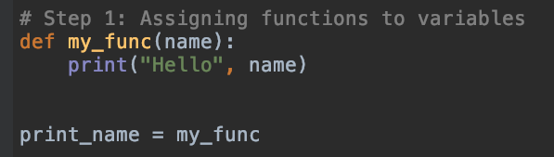

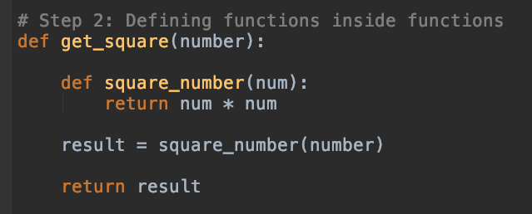

Function Decorators
Fundamentals
Notes:
Before we actually build a decorator though, there are 4 simple fundamental concepts in Python that I will cover into order to make it easier to construct a decorator.

Slide 10
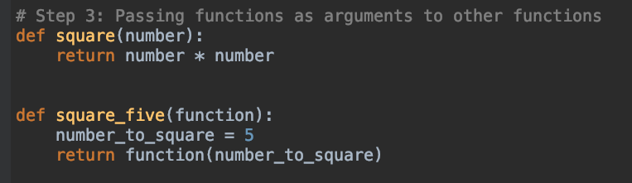

Function Decorators
Fundamentals

Slide 11
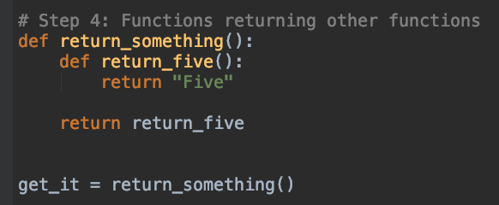

Function Decorators
Fundamentals

Slide 12
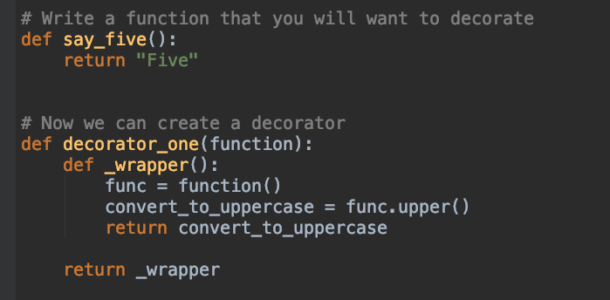

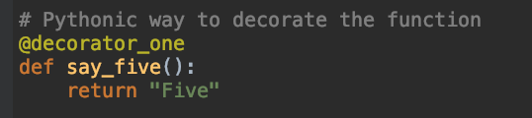

Function Decorators
A simple decorator

Slide 13
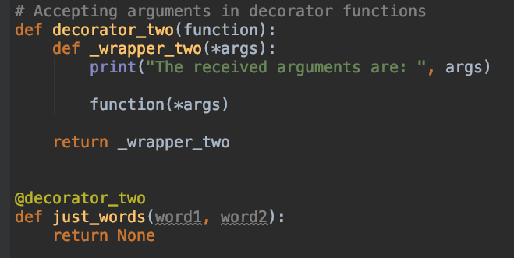

Function Decorators
Passing arguments in the decorator

Slide 14
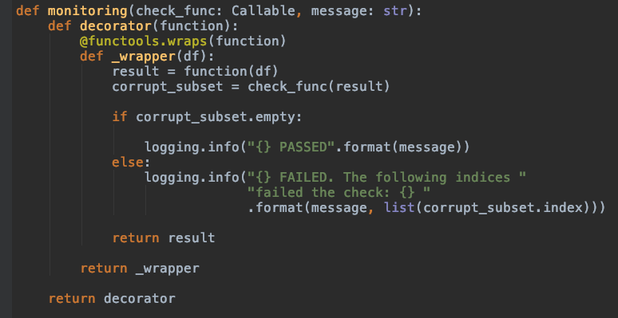
Function Decorators
Let’s construct the monitoring decorator
Notes:
As we have noticed, decorators wrap functions. The original function name, its docstring, and parameter list are all hidden by the wrapper closure.
In order to solve this challenge Python provides a functools.wraps decorator. This decorator copies the lost metadata from the undecorated function to the decorated closure. Let's show how we'd do that.

Slide 15
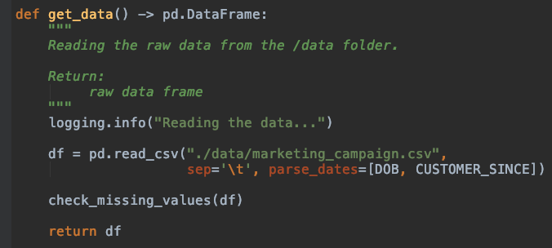

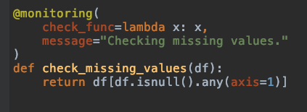
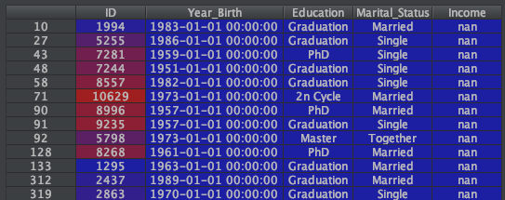
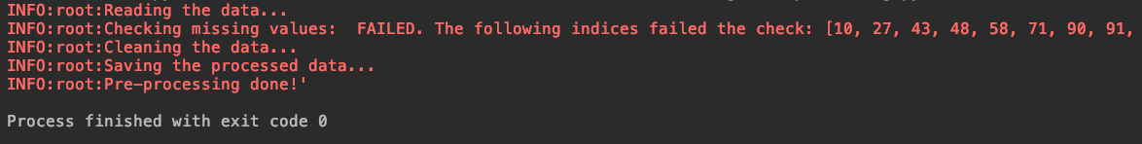
Function Decorators
Data monitoring use case

Slide 16
Thank you!
Questions?
Repo: https://github.com/viktivan19/monitoring

